Slide 1


Gunter Nembach
15.05.2026

Slide 2

Outline
Executive Summary
Introduction
Methodology
Results
Conclusion
Appendix

Slide 3
Executive Summary
Summary of methodologies
Request data via SpaceX API & Web Scraping
Clean and normalize data using Python
EDA (exploratory data analysis): data wrangling/ missing values with Python & SQL
Visual Data analysis with Python/ Plotly/ Folio

Slide 4
Executive Summary
Summary of all results
Falcon 9: Launches for each site
Cape Canaveral, SLC 40: 55
Kennedy, LC-39A: 22
Vandenberg, SLC-4E: 13
Falcon 9: Top 5 Orbits*
ISS (21), VLEO(14), PO(9), LEO(7),SSO(5)
Falcon 9: Top 3 Mission outcomes
Landing Droneship: 41
Failure Landing: 19
Landing Ground Pad: 14
* see appendix for orbit overview

Slide 5
Executive Summary
Summary of all results
Higher Flight Numbers -> higher Payload Mass/ success Rate
No Payload Mass > 10t from Vandenberg 4E
100% Success Rate - Orbits: ES-L1 / GEO/ HEO/ SSO*
Target Orbits with Payload >8t: ISS/ PO/ VLEO
Avoid proximities to railway/ cities/ highways -> safety
Positiv proximities to ocean/ equator -> safety / energy consumption

Slide 6
Introduction
Project background and context
SpaceX operates Starlink satellite internet and significantly reduces launch costs through reusable Falcon 9 rockets (about $62 million vs. over $165 million). A key factor is whether the first stage successfully lands and can be reused, since it performs most of the work and represents a major portion of the cost.
Problems you want to find answers
As data scientists at a competing company SpaceY we use public data and machine learning to predict whether the first stage will land and be reused in order to estimate launch costs and be competitive to SpaceX.

Slide 7

Section 1

Slide 8
Methodology
Executive Summary
Data collection methodology:
Data collected via SpaceX API and Web Scraping
Perform data wrangling
Data was transferred to Panda database and missing values were cleaned
Perform exploratory data analysis (EDA) using visualization and SQL
Perform interactive visual analytics using Folium and Plotly Dash
Perform predictive analysis using classification models
Dividing the dataset into test- and training data, using different classification models like KNN/ Logistic Regression/ … and tuning Hyperparameters with GridSearchCV

Slide 9
Data Collection
The data are collected via
SpaceX API
"https://api.spacexdata.com/v4/rockets/"
Webscraping “https://en.wikipedia.org/w/index.php?title=List_of_Falcon_9_and_Falcon_Heavy_launches&oldid=1027686922”
You need to present your data collection process use key phrases and flowcharts

Slide 10
Data Collection – SpaceX API
The notebook collects SpaceX launch data through REST calls, enriches each launch with rocket, payload, launchpad, and core metadata, and then cleans the result into one analysis-ready table. This makes landing prediction possible because the final dataset contains the key explanatory features needed for modeling
Key Phrases
GET request: Abruf der SpaceX-Launchdaten über die REST API.
JSON normalization: Verschachtelte API-Antworten werden in tabellarische Form überführt.
Helper functions: Anreicherung der Launches mit Rocket-, Payload-, Launchpad- und Core-Metadaten.
Data wrangling: Entfernen von Multi-Core-/Multi-Payload-Fällen und Umwandlung von Datumswerten.
Final dataset: Ein bereinigter Datensatz pro Launch als Grundlage für Analyse und Modellierung.
GitHub URL:
https://github.com/gnembac/IBM_Datascience_Capstone_PRJ/blob/a8c54efc091b1b1d221046e2634f1f7156b684ec/jupyter-labs-spacex-data-collection-api%20(3).ipynb
flowchart TD
A[Start] --> B[GET /v4/launches/past]
B --> C[Load JSON into dataframe]
C --> D[Extract rocket ids]
C --> E[Extract payload ids]
C --> F[Extract launchpad ids]
C --> G[Extract core ids]
D --> H[GET /v4/rockets/{id}]
E --> I[GET /v4/payloads/{id}]
F --> J[GET /v4/launchpads/{id}]
G --> K[GET /v4/cores/{id}]
H --> L[Append booster version]
I --> M[Append payload mass/orbit]
J --> N[Append site name/lat/lon]
K --> O[Append landing and reuse features]
L --> P[Merge into master table]
M --> P
N --> P
O --> P
P --> Q[Clean rows and types]
Q --> R[Final analysis dataset]
R --> S[End]

Slide 11
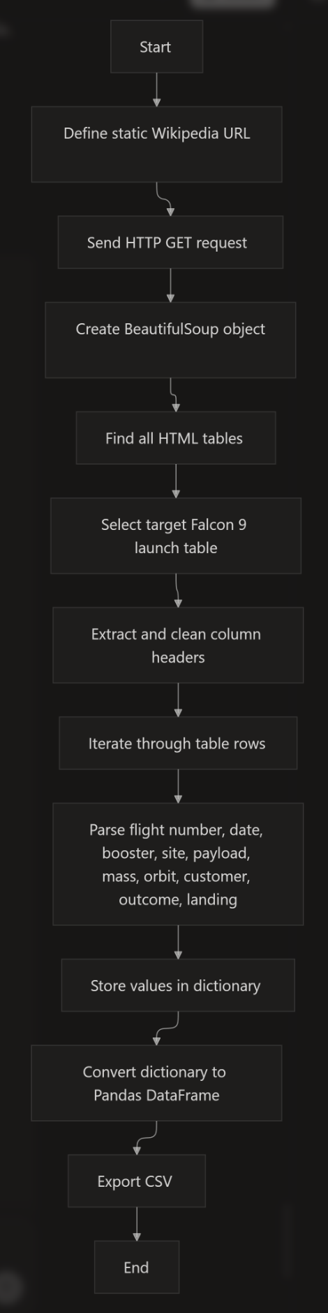
Data Collection - Scraping
The web scraping pipeline starts with a fixed Wikipedia snapshot, parses the HTML with BeautifulSoup, extracts the Falcon 9 launch table, cleans the headers, and loops through each row to build a structured launch dataset. The resulting dataframe is then exported as CSV for later analysis and modeling
Key Phrases
HTTP GET request: Abruf der Wikipedia-Seite über eine feste Snapshot-URL.
BeautifulSoup parsing: Umwandlung des HTML-Dokuments in eine durchsuchbare Struktur.
Target table selection: Auswahl der relevanten Launch-Record-Tabelle aus allen HTML-Tabellen.
Header cleaning: Bereinigung der <th>-Spaltennamen zu lesbaren Feldnamen.
Row parsing: Extraktion und Normalisierung der Launch-Daten aus jeder Tabellenzeile.
DataFrame creation: Aufbau eines strukturierten Pandas-DataFrames.
CSV export: Speichern des bereinigten Datensatzes für die spätere Analyse.
GitHub URL:
https://github.com/gnembac/IBM_Datascience_Capstone_PRJ/blob/c72eb5257a51299c0e52dbd05b9c95d2704f60d0/jupyter-labs-webscraping%20(2).ipynb

Slide 12
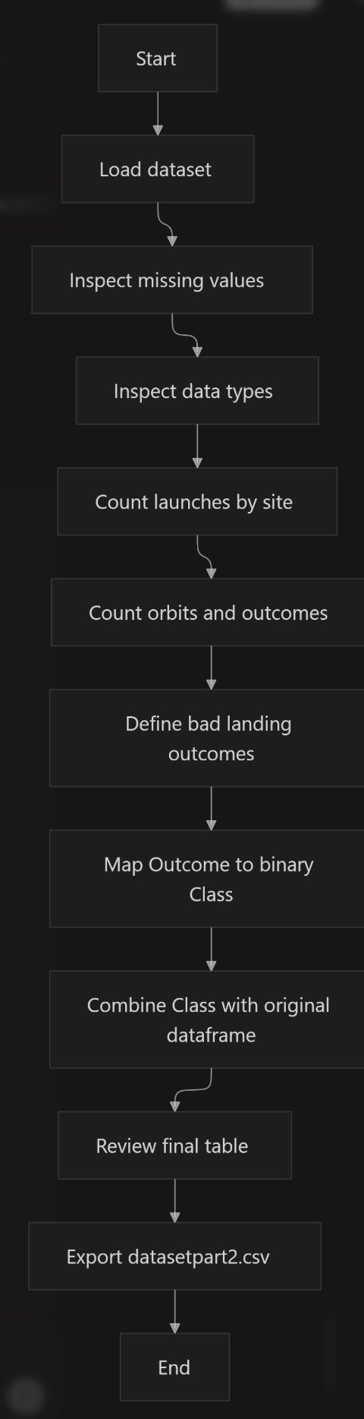
Data Wrangling
The wrangling step starts with the merged SpaceX launch table, then checks missing values and variable types before analyzing launch sites, orbits, and landing outcomes. After identifying the unsuccessful landing patterns, the workflow converts the Outcome column into a binary Class label and exports the final modeling dataset.
Key Phrases
Load cleaned dataset: Start mit der strukturierten Launch-Tabelle aus der vorherigen Phase.
Missing-value check: Prüfung fehlender Werte pro Attribut.
Type inspection: Trennung numerischer und kategorialer Variablen.
Launch count analysis: Anzahl der Starts pro Launch Site.
Orbit analysis: Häufigkeit der Orbit-Typen und Mission Outcomes.
Outcome mapping: Umwandlung der Outcome-Werte in Success/Failure-Klassen.
Label creation: Binäre Zielvariable Class mit 1 = success und 0 = failure.
Feature-ready table: Export des finalen Modellierungsdatensatzes als CSV.
GitHub URL https://github.com/gnembac/IBM_Datascience_Capstone_PRJ/blob/d7b4d9271b0fce764147d878e0a3bf6d99c6e058/labs-jupyter-spacex-Data%20wrangling%20(3).ipynb

Slide 13
EDA with Data Visualization
The notebook used scatter plots to explore how launch success relates to flight number, launch site, orbit type, and payload mass, and it used a bar chart to compare success rates across orbit types. Scatter plots were best for showing patterns and clustering, while the bar chart was best for comparing categorical success rates.
The notebook plots a small set of EDA charts centered on launch success, orbit, payload mass, and launch site behavior. The main goal was to reveal patterns that help explain when Falcon 9 first-stage landings succeed or fail.
Charts plotted
Scatter plot: Flight Number vs. Launch Site, colored by Class. This was used to see whether launch outcomes changed over time at each site and whether success clustered by site.
Bar chart: Success Rate by Orbit Type. This was used to compare the average success rate across orbit categories, which is a simple way to rank orbit types by landing outcome.
Scatter plot: Flight Number vs. Orbit Type. This was used to inspect whether later flights were associated with different orbit patterns and whether some orbit types showed more successful launches as flight number increased.
Scatter plot: Payload Mass vs. Orbit Type. This was used to check whether payload weight was linked to specific orbit choices and whether payload mass appeared related to landing success.
Why these charts
Scatter plots were chosen for relationships between one numeric variable and one categorical variable because they make trends, clustering, and separation between success classes easy to see.
Bar charts were chosen for orbit success rate because the task was to compare categories directly, and a bar chart makes relative performance easy to read.
Color coding by Class was used to separate success and failure visually, which makes landing patterns more interpretable without adding extra tables.
What the visuals showed
The Flight Number vs. Launch Site chart was used to compare site behavior over time and to spot differences between launch locations.
The success-rate bar chart highlighted which orbit types were more favorable for successful landings.
The Flight Number vs. Orbit plot suggested that some orbit types, especially LEO, showed a clearer relationship with increasing flight number than others.
The Payload Mass vs. Orbit plot helped show how payload constraints differ by orbit, including the observation that very heavy payloads were not launched from VAFB-SLC in the notebook’s analysis.
GitHub URLhttps://github.com/gnembac/IBM_Datascience_Capstone_PRJ/blob/43a036964402ff6f4bec78a0f9acdd419aeee439/edadataviz.ipynb

Slide 14
EDA with SQL
Loaded the SpaceX dataset into SQLite. I imported the CSV into a table called SPACEXTBL, then created a cleaned working table SPACEXTABLE after removing blank rows.
Listed all unique launch sites. I used SELECT DISTINCT LaunchSite FROM SPACEXTABLE to identify the available launch locations.
Filtered launch sites by string pattern. I queried launch sites beginning with CCA using a LIKE condition to return the CCAFS-related sites.
Computed total payload mass for NASA CRS missions. I used SUM(PAYLOADMASSKG) with a customer filter to measure the total payload carried for NASA CRS launches.
Selected payload details for NASA CRS records. I retrieved payload mass, booster version, and customer fields to inspect individual NASA CRS launches more closely.
Calculated average payload mass for booster version F9 v1.1. I used AVG(PAYLOADMASSKG) with a booster-version filter to summarize typical payload weight for that rocket version.
Found the first successful ground pad landing date. I used MIN(Date) filtered by LandingOutcome = 'Success ground pad' to identify when that milestone first occurred.
Listed boosters with successful drone ship landings and mid-range payloads. I filtered by LandingOutcome = 'Success drone ship' and PAYLOADMASSKG BETWEEN 4000 AND 6000 to find matching boosters.
Counted successful vs. failed mission outcomes. I used conditional counting with CASE WHEN expressions to compare overall success and failure totals.
Found boosters carrying the maximum payload. I used a subquery with MAX(PAYLOADMASSKG) to return every booster version tied to the heaviest payload.
Extracted 2015 drone-ship failure records. I used date substring logic to pull month-based records for 2015 where the landing outcome was a drone-ship failure.
Ranked landing outcomes by frequency. I grouped by LandingOutcome, counted occurrences, and sorted descending to see which landing types appeared most often between 2010-06-04 and 2017-03-20.
GitHub URL: https://github.com/gnembac/IBM_Datascience_Capstone_PRJ/blob/4fc42e1cc0894dbc19d0144c427e8c40f5a64434/jupyter-labs-eda-sql-coursera_sqllite%20(4).ipynb

Slide 15
Build an Interactive Map with Folium
Map base layer: I created a folium.Map centered on the NASA Johnson Space Center as the starting view for the launch-site analysis. This gave a geographic reference point for all later objects on the map.
Circle objects: I added folium.Circle objects for each launch site, with a fixed radius and popup label showing the site name. The circles were used to make the launch locations easy to spot and to provide a consistent visual footprint for each site.
Text-labeled markers: I added folium.Marker objects using DivIcon text labels such as NASA JSC, CCAFS LC-40, CCAFS SLC-40, KSC LC-39A, and VAFB SLC-4E. These labels made the map readable at a glance without needing to click each point.
Success/failure markers: I added color-coded folium.Marker objects for launch records, with green for success and red for failure. This was done so the launch outcome could be recognized immediately from the marker color.
Marker clusters: I used folium.plugins.MarkerCluster to group many nearby success/failure points. Clustering keeps the map usable when there are many launches in the same area and prevents visual overlap.
Mouse position control: I added folium.plugins.MousePosition so coordinates appear while moving the cursor over the map. This helped me identify exact points of interest such as coastline, railway, highway, or city locations.
Distance lines: I created folium.PolyLine objects from each launch site to a nearby proximity point, such as coastline or another landmark. The lines were added to visualize distance relationships directly on the map instead of only listing numeric values.
Distance labels: I used a marker with a DivIcon to display the computed distance, such as a distance in km. This made the map self-explanatory by tying the line to a numeric distance value.
Why these objects
Circles and labels were used for site identification and to make launch locations easy to compare spatially.
Colored markers were used for success classification so launch outcomes could be interpreted visually.
Clusters were used for density handling when many launches occupied the same region.
Mouse position and distance lines were used for proximity analysis to explore how close launch sites are to coastlines, highways, railways, or cities.
Git Hub URL:https://github.com/gnembac/IBM_Datascience_Capstone_PRJ/blob/5dfcd4ff9156e9b0c30787707afdd3cd3507c631/lab_jupyter_launch_site_location.ipynb

Slide 16
Build a Dashboard with Plotly Dash
Pie chart for launch success by site: I added a pie chart that shows the distribution of successful launches across all launch sites when “All Sites” is selected. This gives a quick high-level view of which sites contributed most to successful missions.
Pie chart for success vs. failure at one site: When a specific launch site is selected, the pie chart switches to a success/failure split for that site. I added this because it makes site-level performance easier to compare than using raw counts alone.
Scatter chart for payload vs. outcome: I added a scatter plot with payload mass on the x-axis and launch outcome on the y-axis. This was included to check whether payload size appears related to launch success or failure.
Color grouping by booster category: The scatter plot colors points by booster version category. I used this to make it easier to see whether different booster generations behave differently across payload ranges.
Interactions
Launch site dropdown: I added a dropdown that lets the user switch between “All Sites” and individual launch sites. This interaction makes the dashboard exploratory rather than static.
Payload range slider: I added a range slider to filter launches by payload mass. This helps users focus on a specific payload interval and see whether success patterns change with weight.
Dynamic callbacks: Both charts update automatically when the dropdown or slider changes. I added callbacks so the dashboard responds instantly without reloading the page.
Hover information: The scatter plot includes hover data such as launch site, payload mass, and outcome. I added this so users can inspect individual launches without cluttering the chart.
Why these choices
The pie charts are best for categorical proportion questions, such as “how much success came from each site” or “what is the success/failure mix at one site.”
The scatter plot is best for seeing relationships between payload mass and mission outcome, especially when combined with booster category coloring.
The dropdown and slider make the dashboard interactive and support drill-down analysis, which is useful for comparing launch sites and payload ranges side by side
Git Hub URL:https://github.com/gnembac/IBM_Datascience_Capstone_PRJ/blob/8a1ffe090f7609bce76c20859dbf3591691bb5ca/spacex-dash-app%20(2).py

Slide 17
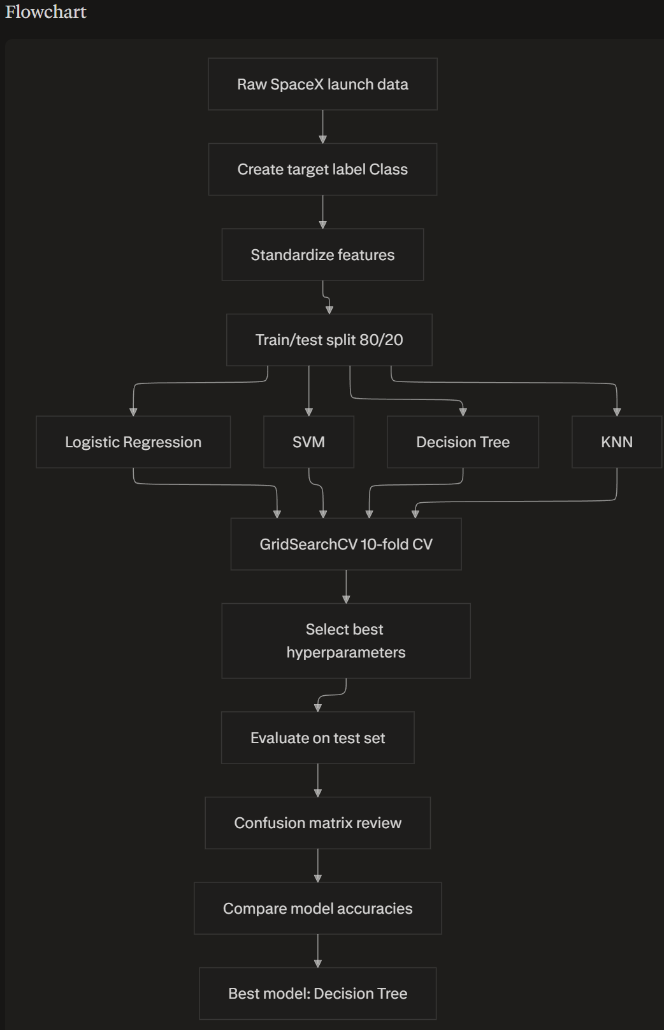
Predictive Analysis (Classification)
Process summary
Feature preparation: Created the target label Class, standardized the predictors with StandardScaler, and split the data into train/test sets with an 80/20 split.
Baseline modeling: Trained and tuned four classifiers: Logistic Regression, Support Vector Machine, Decision Tree, and K-Nearest Neighbors.
Hyperparameter search: Used GridSearchCV with 10-fold cross-validation to tune each model and select the best parameter combination.
Validation scoring: Compared models using cross-validation accuracy and then checked test-set accuracy for the fitted best estimator.
Error inspection: Plotted confusion matrices to inspect misclassifications, especially false positives and false negatives.
Model selection: Chose the model with the highest test performance, which was the Decision Tree classifier.
Best model results
Logistic Regression: Best CV accuracy about 0.8464, test accuracy about 0.8333.
SVM: Best CV accuracy about 0.8482, with best parameters C=1.0, gamma=0.03162277660168379, kernel='sigmoid'.
KNN: Best CV accuracy about 0.8482, with best parameters algorithm='auto', n_neighbors=10, p=1.
Decision Tree: Best CV accuracy about 0.8893, with best parameters criterion='entropy', max_depth=16, max_features='sqrt', min_samples_leaf=2, min_samples_split=2, splitter='random'.
Winner: The notebook explicitly states that the decision tree has the best accuracy.
Why this process
Standardization was needed because the feature set contains mixed scales, and scale-sensitive models like SVM and KNN benefit from it.
Grid search with cross-validation was used to reduce overfitting and make hyperparameter selection more reliable.
Confusion matrices were added because accuracy alone can hide asymmetric errors, especially false positives in landing prediction.
Git Hub URL: https://github.com/gnembac/IBM_Datascience_Capstone_PRJ/blob/6e21daf03c41eb1c9b2a88be2b37c3e93329804c/SpaceX_Machine%20Learning%20Prediction_Part_5.ipynb

Slide 18
Results
Exploratory analysis
The EDA results showed that launch success varies by site, orbit, and payload mass, which justified deeper drill-down analysis rather than treating all launches as one population.
The notebook used scatter plots and bar charts to reveal patterns in launch site behavior, orbit-specific success rates, and payload distribution across missions.
The SQL notebook reinforced this by summarizing key mission facts such as unique launch sites, payload totals, average payloads, first successful ground-pad landing date, and landing outcome frequencies.
Interactive demo
The interactive Folium demo mapped launch sites with circles, labeled markers, and outcome markers so the viewer could inspect where launches happened and how success/failure clustered geographically.
The dashboard added a dropdown, a payload range slider, a success pie chart, and a payload-vs-outcome scatter plot to support drill-down exploration by launch site and payload range.
These interactions were designed to make the analysis exploratory rather than static, letting the user change the slice of data instantly.
Predictive results
The machine-learning notebook standardized the features, split the data into training and test sets, and tuned Logistic Regression, SVM, Decision Tree, and KNN models using 10-fold cross-validation.
The best-performing classifier was the Decision Tree, with validation accuracy about 0.8893 and the best tuned parameters criterion=entropy, max_depth=16, max_features=sqrt, min_samples_leaf=2, min_samples_split=2, and splitter=random.
The notebook compared models on test data and used confusion matrices to inspect misclassification patterns, especially false positives.
Presentation-ready version
Exploratory data analysis results: launch success depends on launch site, orbit type, and payload mass; unique launch sites and landing outcome counts confirm strong structure in the data.
Interactive analytics demo in screenshots: Folium maps, labeled launch sites, success/failure markers, and a Dash dashboard with dropdowns and sliders show the data interactively.
Predictive analysis results: after scaling and hyperparameter tuning, the decision tree was the best classifier among the tested models.

Slide 19

Section 2

Slide 20
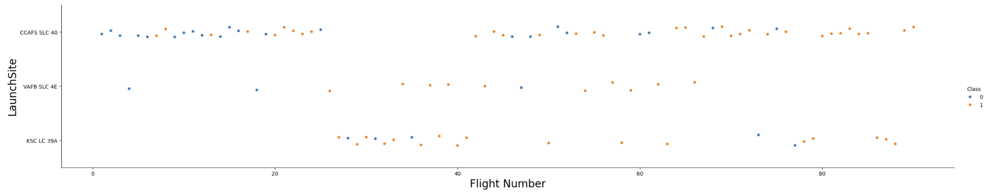
Flight Number vs. Launch Site
Cape Canaveral, SLC 40
Kennedy, LC-39A
Vandenberg, SLC-4E
Higher Flight Number means more lessons learned and improvements for safe flights

Slide 21
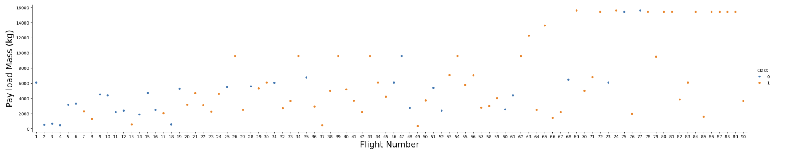
Payload vs. Launch Site
Higher Flight Number indicates in general possible higher payloads

Slide 22
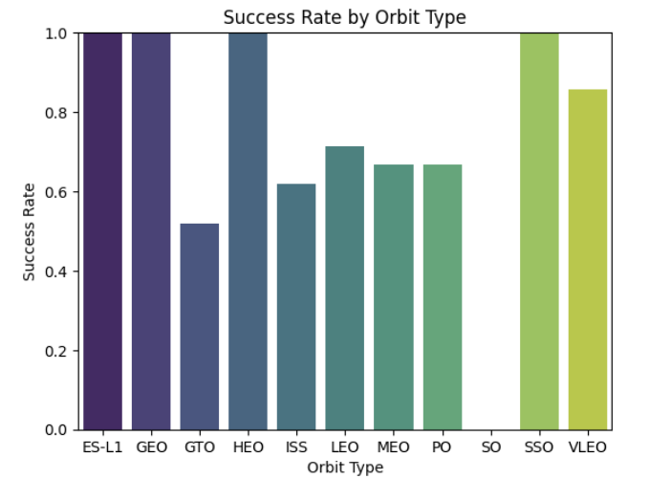
Success Rate vs. Orbit Type
Oribts with 100% success rate:
ES-L1
GEO
HEO
SSO

Slide 23
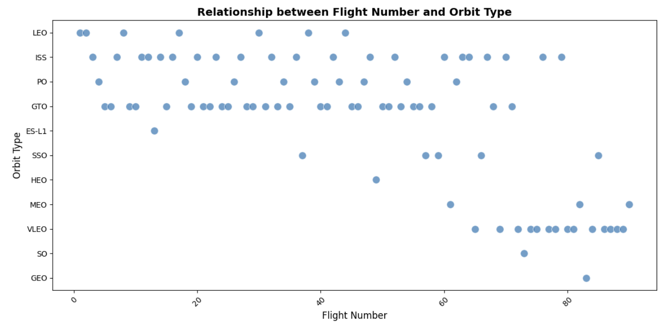
Flight Number vs. Orbit Type
LEO/ ISS/ PO/ GTO/ ES-L1 beginning with lower Flight Numbers
GEO/ SO/ VLEO/ MEO/ HE starting with Flight Numbers > #35

Slide 24
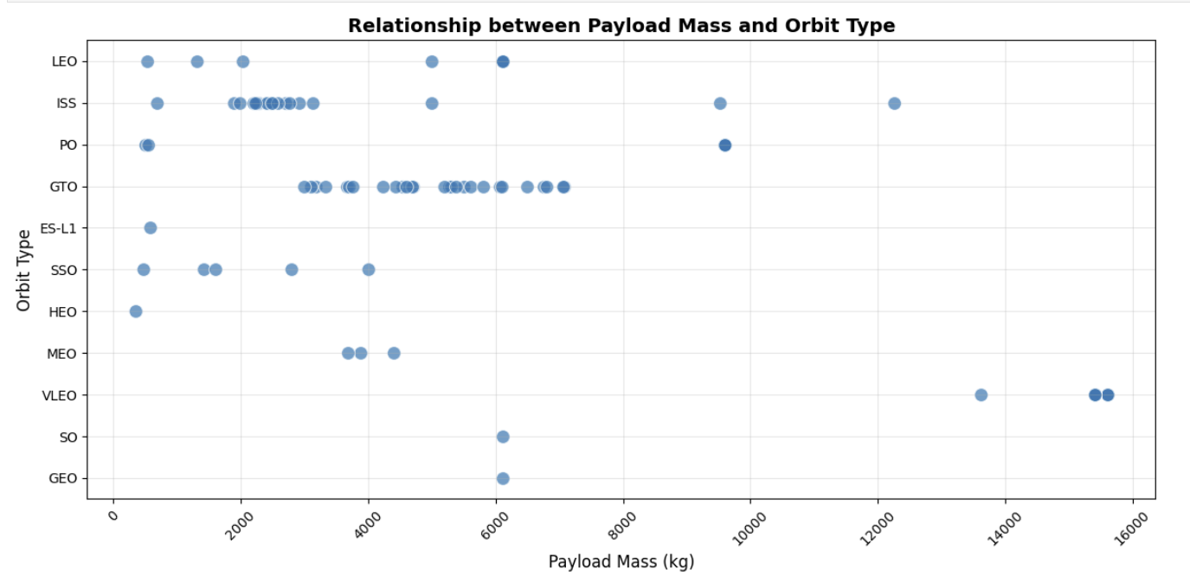
Payload vs. Orbit Type
>8000kg Payload Mass only PO/ ISS/ VLEO Orbits are the destinations for SpaceX

Slide 25
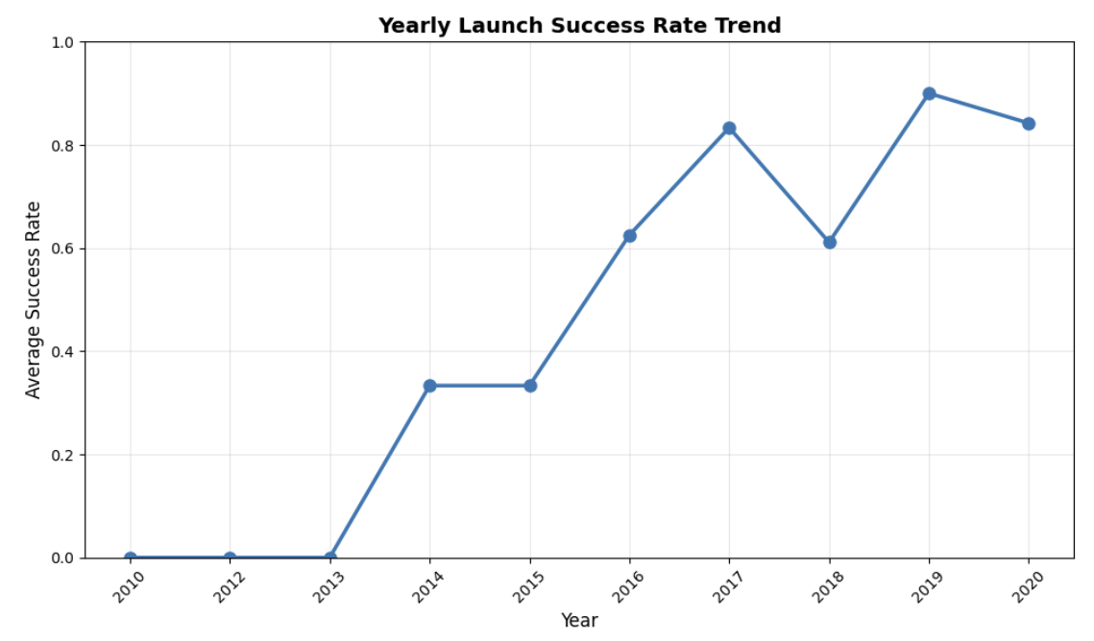
Launch Success Yearly Trend
more years of launching SpaceX means a higher average success rate

Slide 26
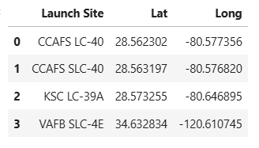
All Launch Site Names
Space X launch facilities: Cape Canaveral Space Launch Complex 40 VAFB SLC 4E , Vandenberg Air Force Base Space Launch Complex 4E (SLC-4E), Kennedy Space Center Launch Complex 39A KSC LC 39A .The location of each Launch Is placed in the column

Slide 27
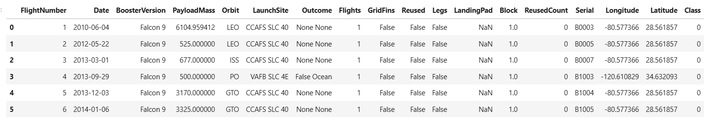
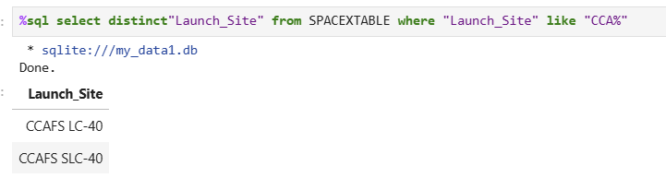
Launch Site Names Begin with 'CCA'
Flight Numbers 0/1/2/4/5 starts with the Names ‘CCA’

Slide 28
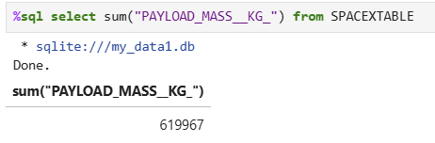
Total Payload Mass
Total Payload Mass Space X = 619967 kg

Slide 29
Average Payload Mass by F9 v1.1
average payload mass carried by booster version F9 v1.1:
avg("PAYLOAD_MASS__KG_"): 2534.6666666666665kg acc. the database

Slide 30
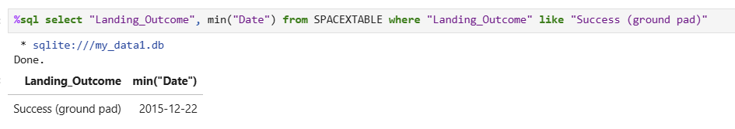
First Successful Ground Landing Date
Find the dates of the first successful landing outcome on ground pad
First successful Landing on ground pad at the 22th December 2015

Slide 31
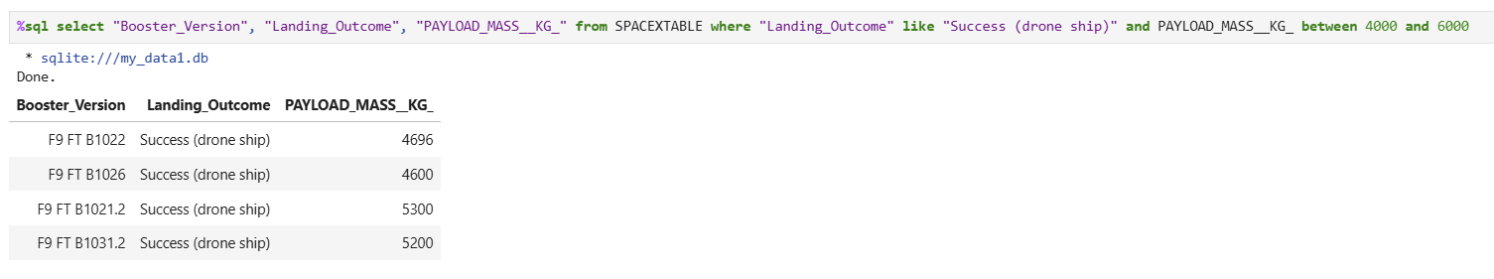
Successful Drone Ship Landing with Payload between 4000 and 6000
Booster Version for successful Droneship landing

Slide 32
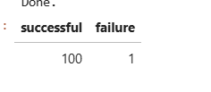
Total Number of Successful and Failure Mission Outcomes
SQL Querry Mission outcomes

Slide 33
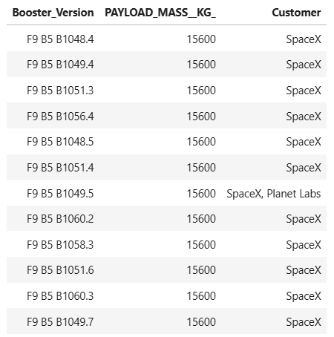
Boosters Carried Maximum Payload
Boosters with max. Payload and Customer

Slide 34
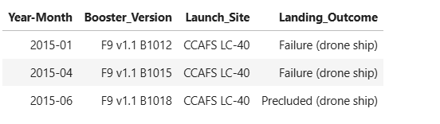
2015 Launch Records
3 failed landing outcomes on droneship

Slide 35
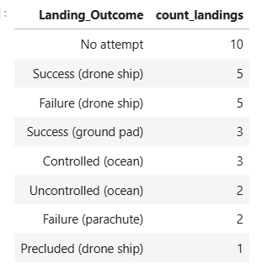
Rank Landing Outcomes Between 2010-06-04 and 2017-03-20
Landing outcomes ranking descending from highest to lowest

Slide 36

Section 3

Slide 37
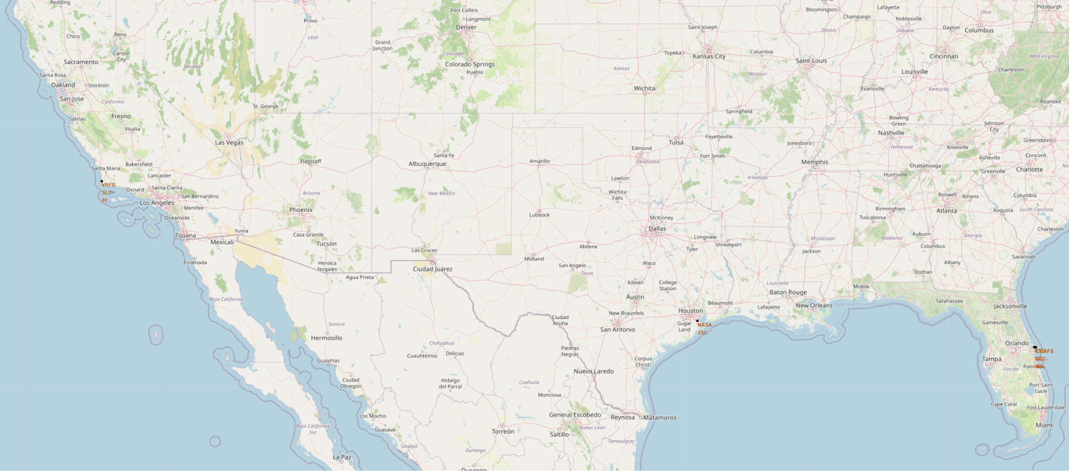
USA SPACEX LAUNCH SIDES OVERVIEW
All launch sides are in the proximity of the ocean and the equator - launch sides are not in the proximity of cities/ railways/ highways/ highly populated areas

Slide 38
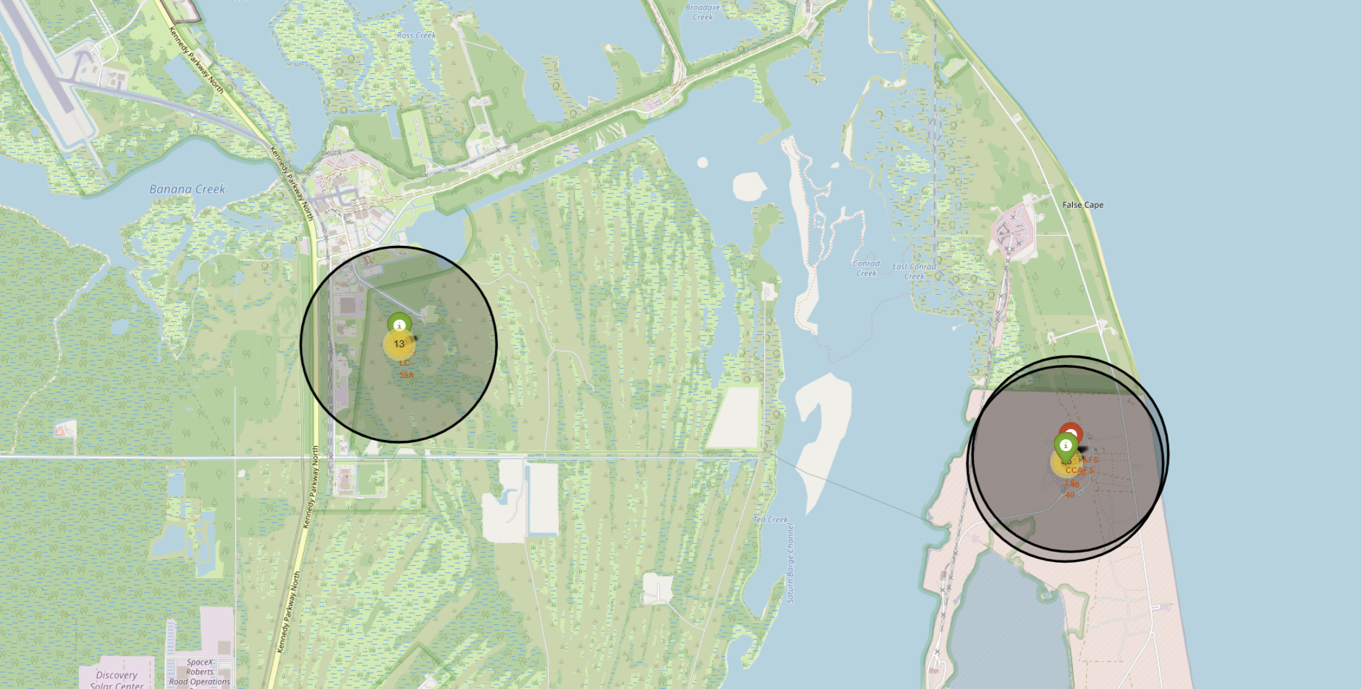
Success/ Fail status on Launch Sides
Green markers = success - Red markers = failed

Slide 39
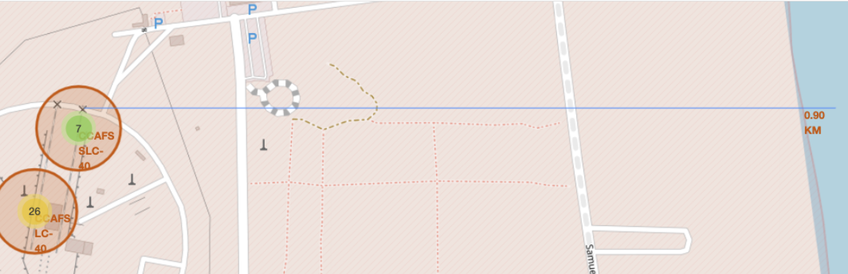
Proximity Map for Launch Side
Distance from the ocean

Slide 40

Section 4

Slide 41
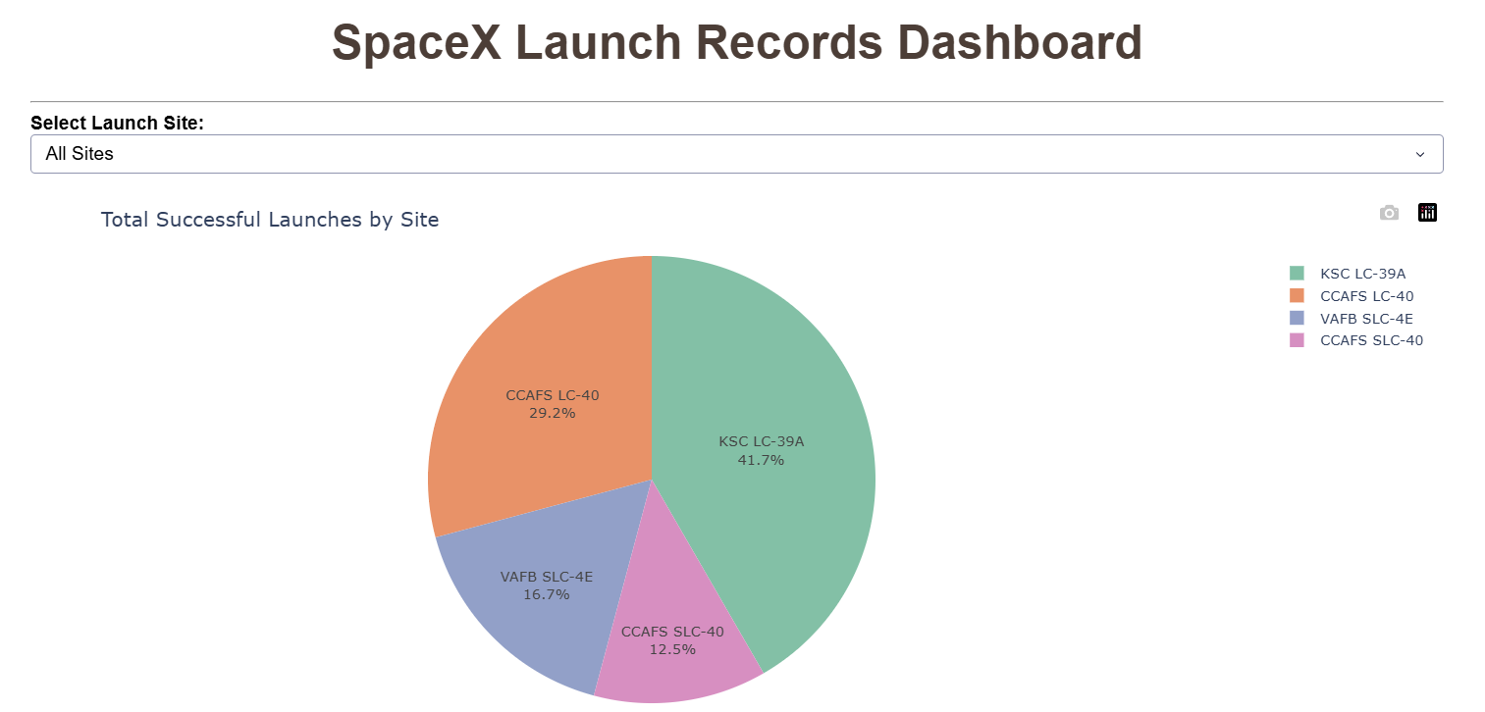
Launch Records Dashboard
CCAFS LC-40 (höchste absolute Success-Count im Pie Chart)

Slide 42
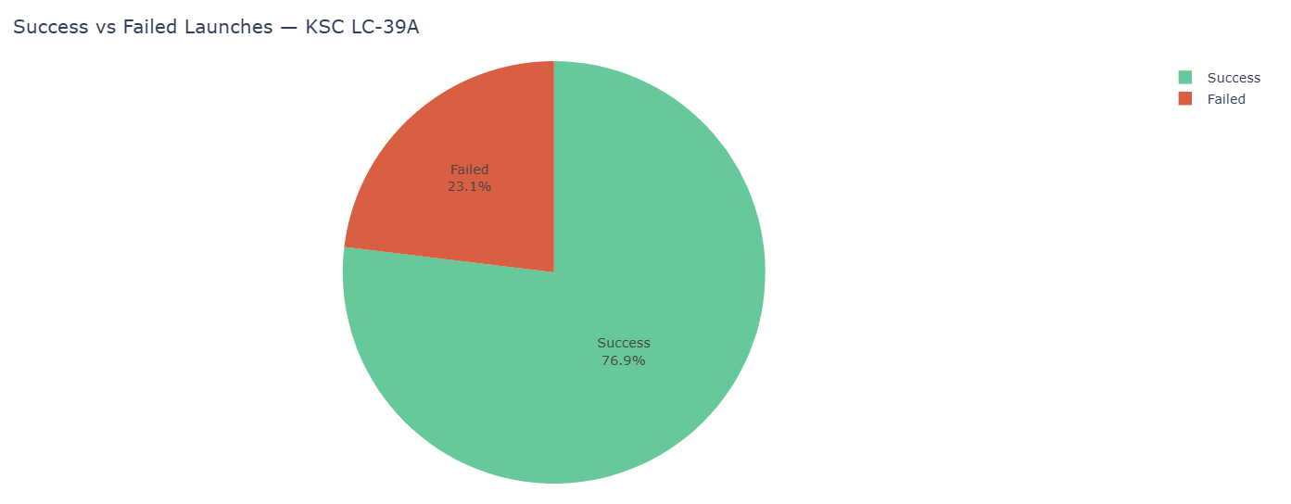
Score Success/ Fail
KSC LC-39A (höchstes Verhältnis Success/(Success+Fail))

Slide 43
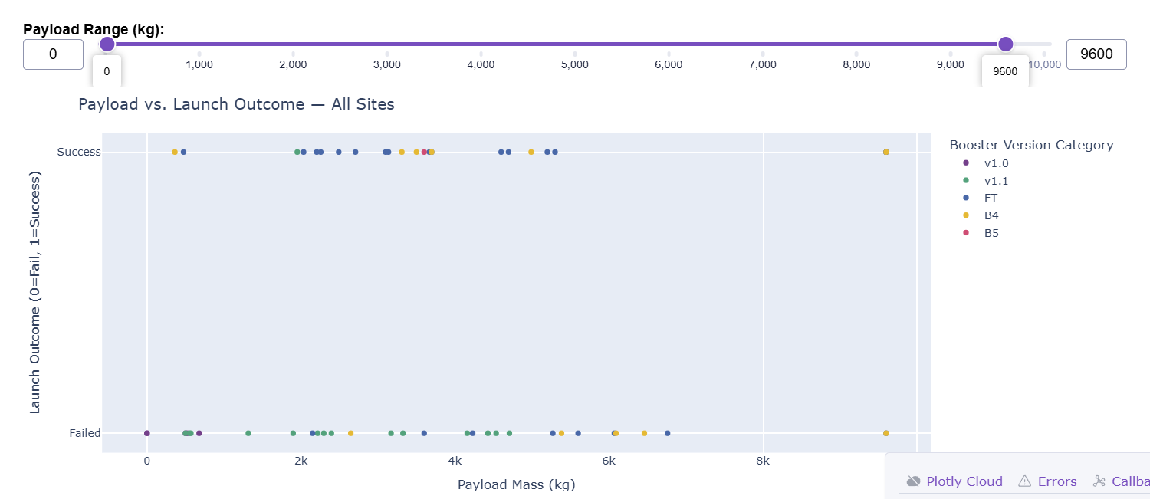
Payload Mass vs. Launch Outcome
~5000–6000 kg (meiste(class=1)-Punkte im Scatter)
>9000 kg (meist(class=0)-Punkte bei hohen Payloads)

Slide 44

Section 5

Slide 45
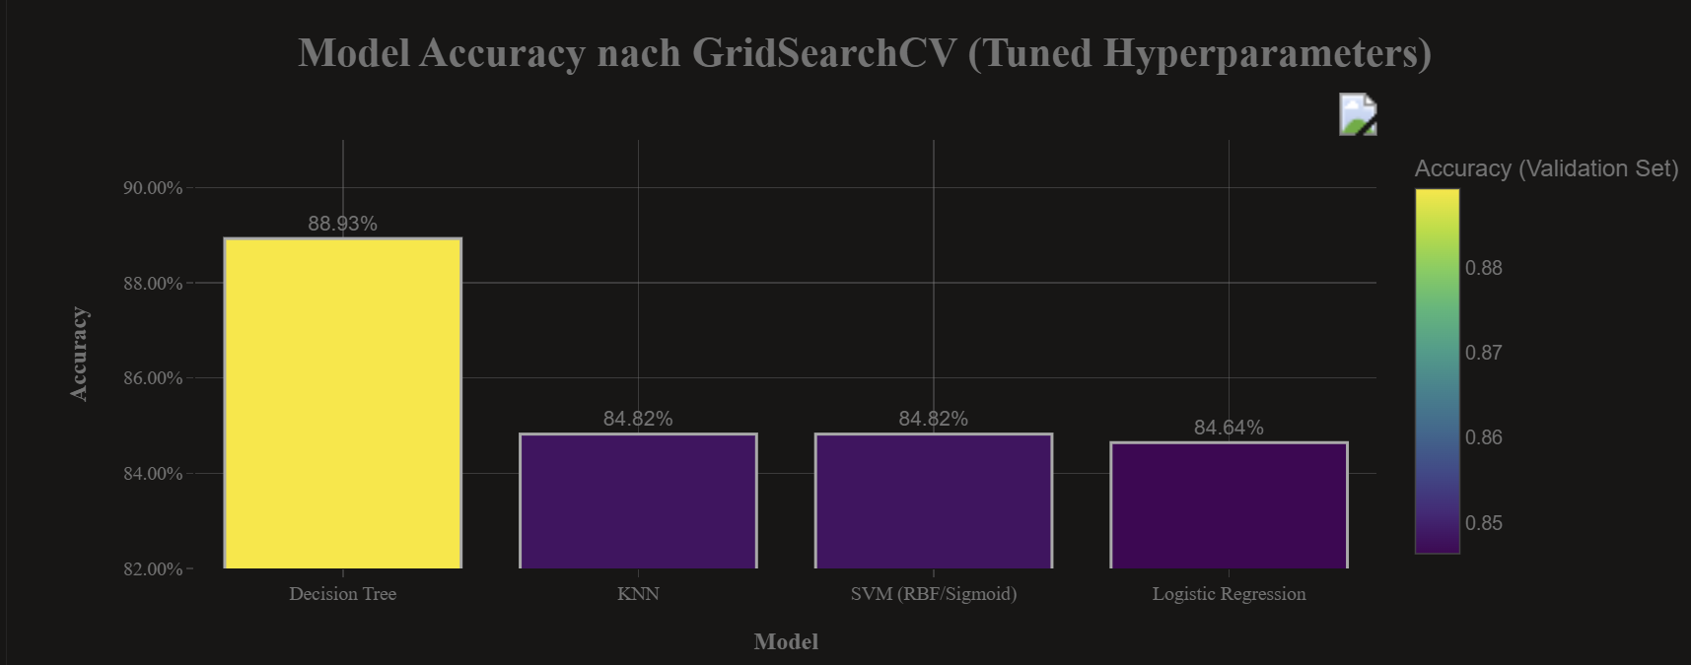
Classification Accuracy
The Model with the best accuracy is the DecisionTree Model

Slide 46
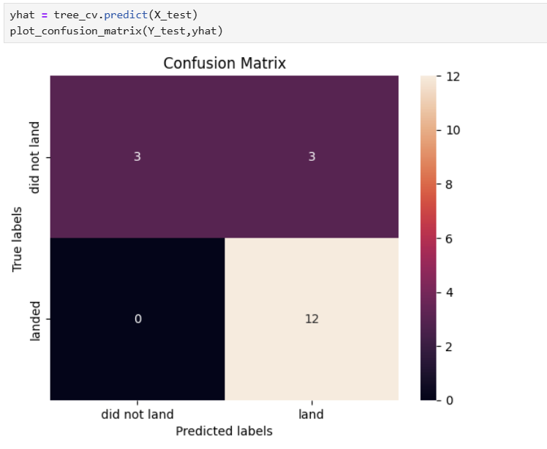
Confusion Matrix - DecisionTree
The accuracy with 0,889 from decisionTree is better then the accuracy from the other algorithms

Slide 47
Conclusions
DecisionTree is the best fitting Model with more than 4,2%points better than the next model
All other models are in the very close range 84,7% accuracy
Hyperparameter-Tuning works best with DecisionTree
RandomForest maybe better than DecisionTree

Slide 48
Appendix
Include any relevant assets like Python code snippets, SQL queries, charts, Notebook outputs, or data sets that you may have created during this project

Slide 49
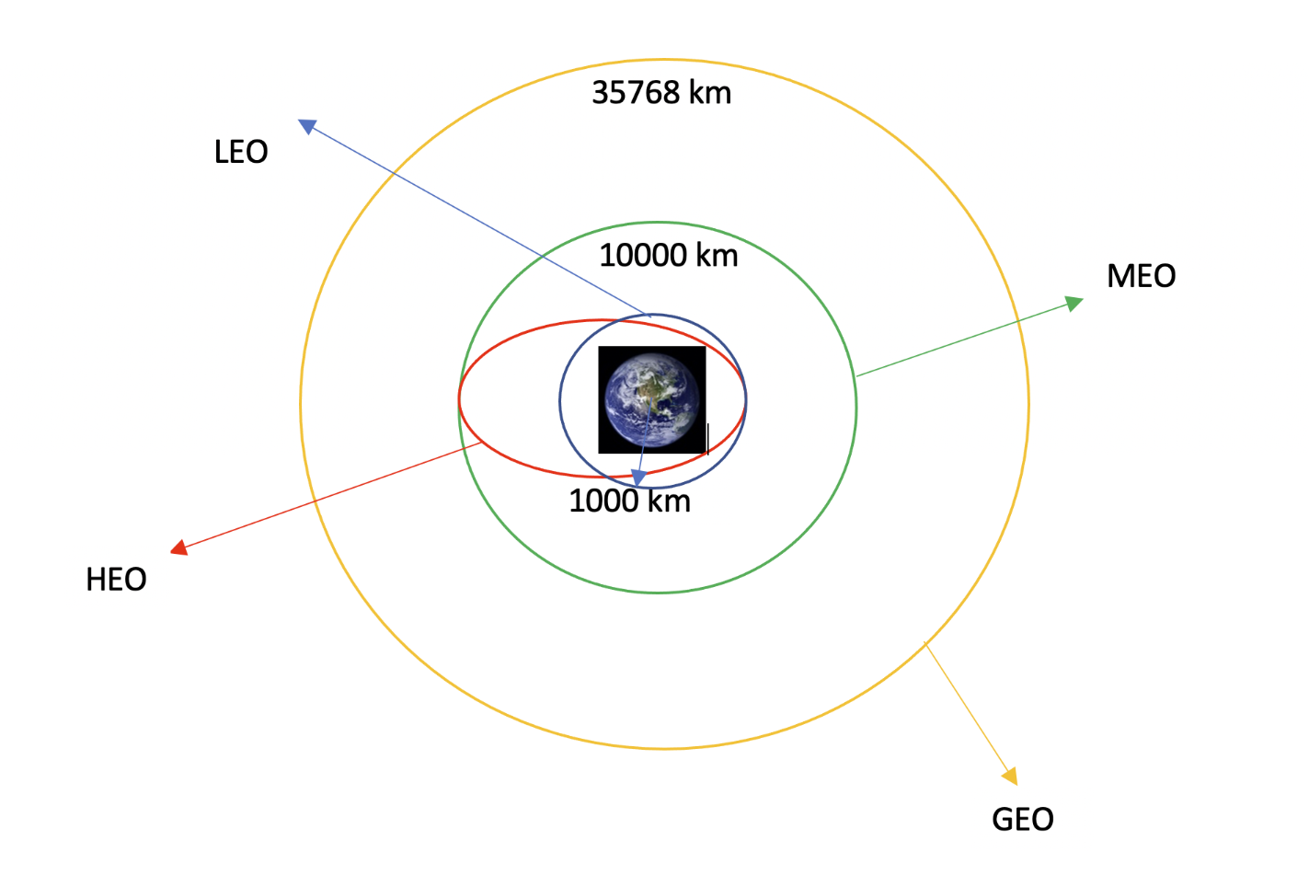
Appendix
LEO: Low Earth orbit (LEO)is an Earth-centred orbit with an altitude of 2,000 km (1,200 mi) or less (approximately one-third of the radius of Earth),[1] or with at least 11.25 periods per day (an orbital period of 128 minutes or less) and an eccentricity less than 0.25.[2] Most of the manmade objects in outer space are in LEO [1].
VLEO: Very Low Earth Orbits (VLEO) can be defined as the orbits with a mean altitude below 450 km. Operating in these orbits can provide a number of benefits to Earth observation spacecraft as the spacecraft operates closer to the observation[2].
GTO(Geostationary Transfer Orbit): A geostationary transfer orbit is an elliptical Earth orbit used to transfer satellites from low Earth orbit (LEO) to geostationary orbit (GEO). In a GTO, the perigee (closest point to Earth) is much lower than GEO altitude, while the apogee (farthest point) reaches approximately 22,236 miles (35,786 kilometers) above Earth’s equator — the altitude of a geostationary orbit. Satellites in GTO use onboard propulsion to circularize their orbit at GEO altitude, where they can provide services such as weather monitoring, communications, and surveillance. [3] .
SSO (or SO): It is a Sun-synchronous orbit also called a heliosynchronous orbit is a nearly polar orbit around a planet, in which the satellite passes over any given point of the planet's surface at the same local mean solar time [4] .
ES-L1 :At the Lagrange points the gravitational forces of the two large bodies cancel out in such a way that a small object placed in orbit there is in equilibrium relative to the center of mass of the large bodies. L1 is one such point between the sun and the earth [5] .
HEO A highly elliptical orbit, is an elliptic orbit with high eccentricity, usually referring to one around Earth [6].
ISS A modular space station (habitable artificial satellite) in low Earth orbit. It is a multinational collaborative project between five participating space agencies: NASA (United States), Roscosmos (Russia), JAXA (Japan), ESA (Europe), and CSA (Canada) [7]
MEO Geocentric orbits ranging in altitude from 2,000 km (1,200 mi) to just below geosynchronous orbit at 35,786 kilometers (22,236 mi). Also known as an intermediate circular orbit. These are "most commonly at 20,200 kilometers (12,600 mi), or 20,650 kilometers (12,830 mi), with an orbital period of 12 hours [8]
HEO Geocentric orbits above the altitude of geosynchronous orbit (35,786 km or 22,236 mi) [9]
GEO It is a circular geosynchronous orbit 35,786 kilometres (22,236 miles) above Earth's equator and following the direction of Earth's rotation [10]
PO It is one type of satellites in which a satellite passes above or nearly above both poles of the body being orbited (usually a planet such as the Earth [11]
Orbit definition

Slide 50


